Slide 1


Basic Requirements and Prototype of Application

Slide 2
Application Name:
“Catch your Mon€y”

Slide 3


Requirements
Category
Transaction Method
Comment Section
Is the transaction recurring?
Security
Transaction Report with filters
Currency Selection

Slide 4
Estimated Time for the Tasks

Slide 5
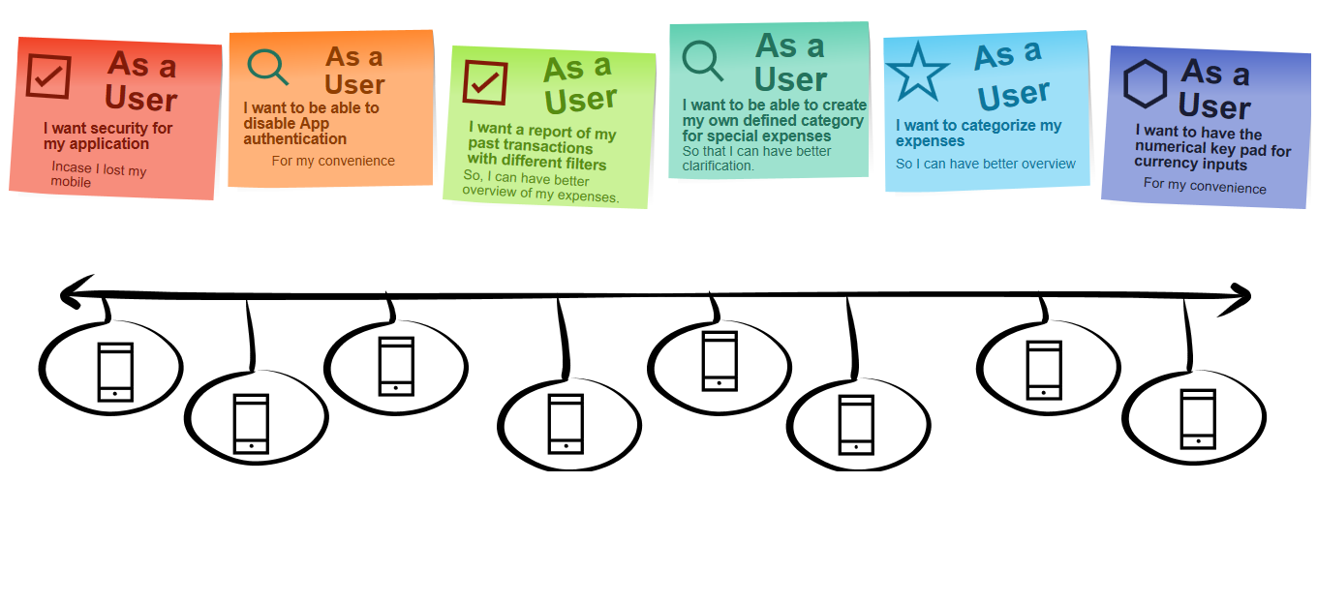
User Stories
Notes:
make sure the goals are clear and the vision is aligned with the objectives
decision maker regarding what features the product will have
remove challenges faced by the team
Establishing an environment where the team can be effective

Slide 6
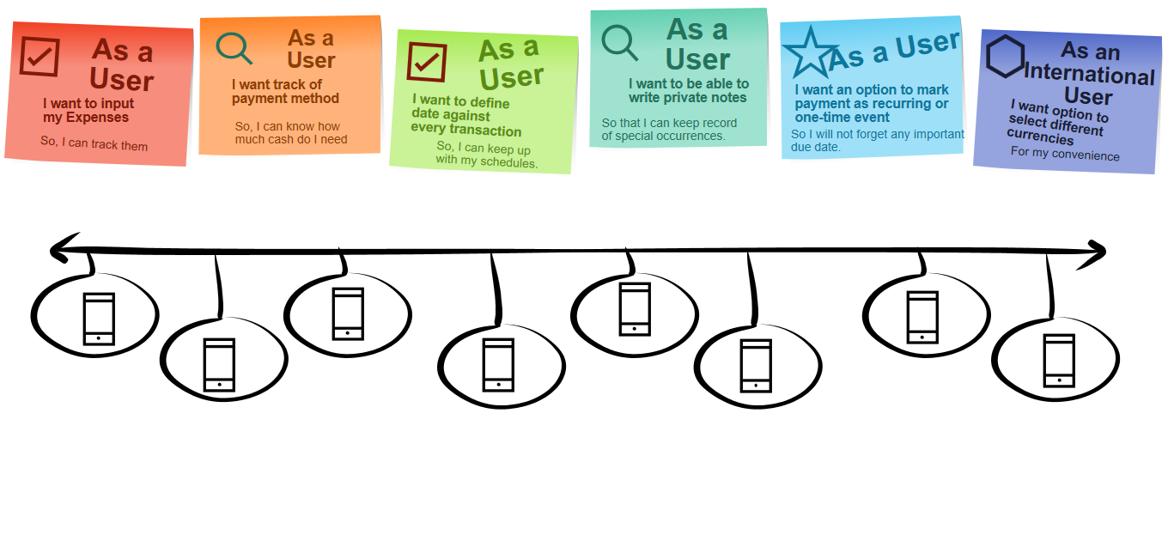
User Stories
Notes:
make sure the goals are clear and the vision is aligned with the objectives
decision maker regarding what features the product will have
remove challenges faced by the team
Establishing an environment where the team can be effective

Slide 7
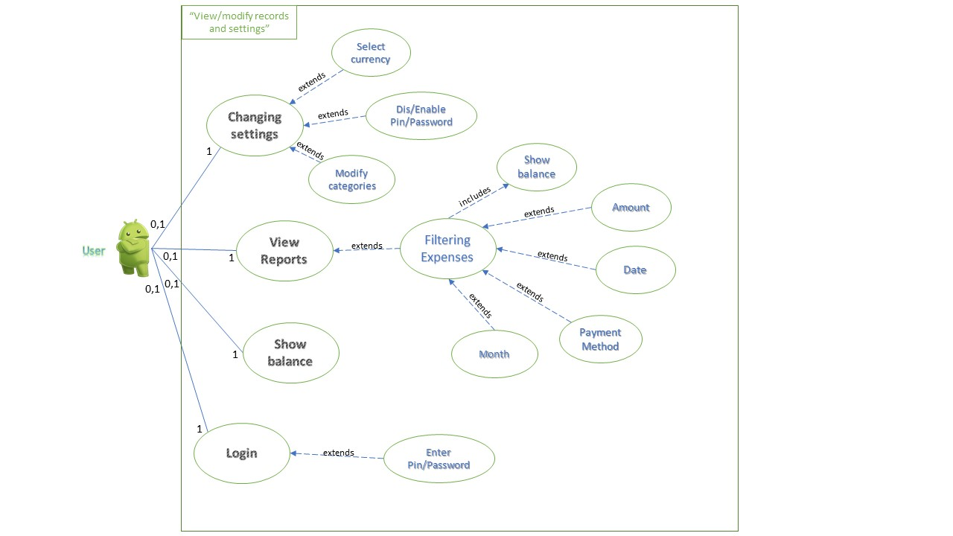
Use Case Diagram

Slide 8
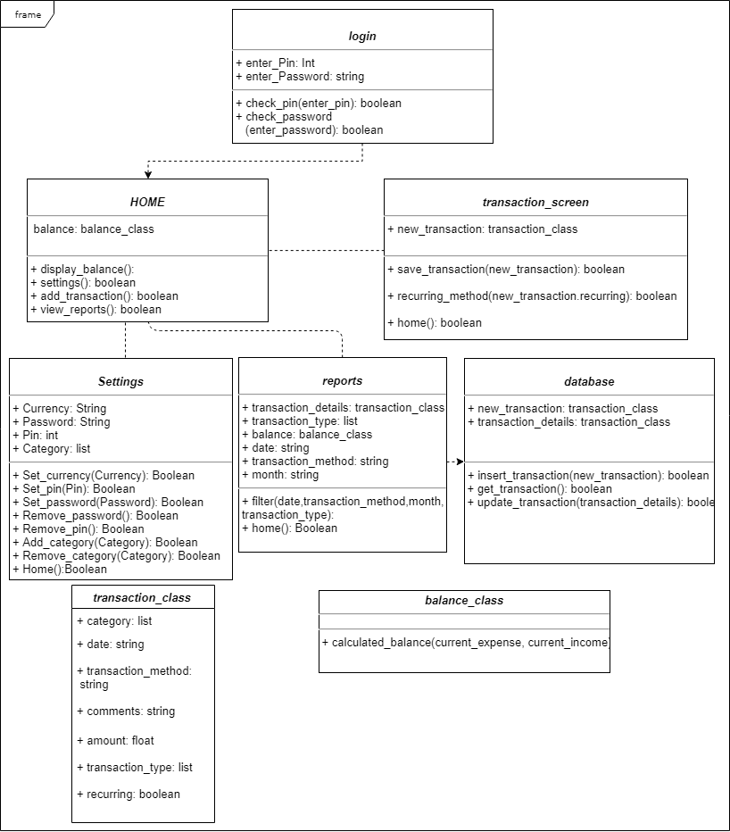
Class Diagram

Slide 9
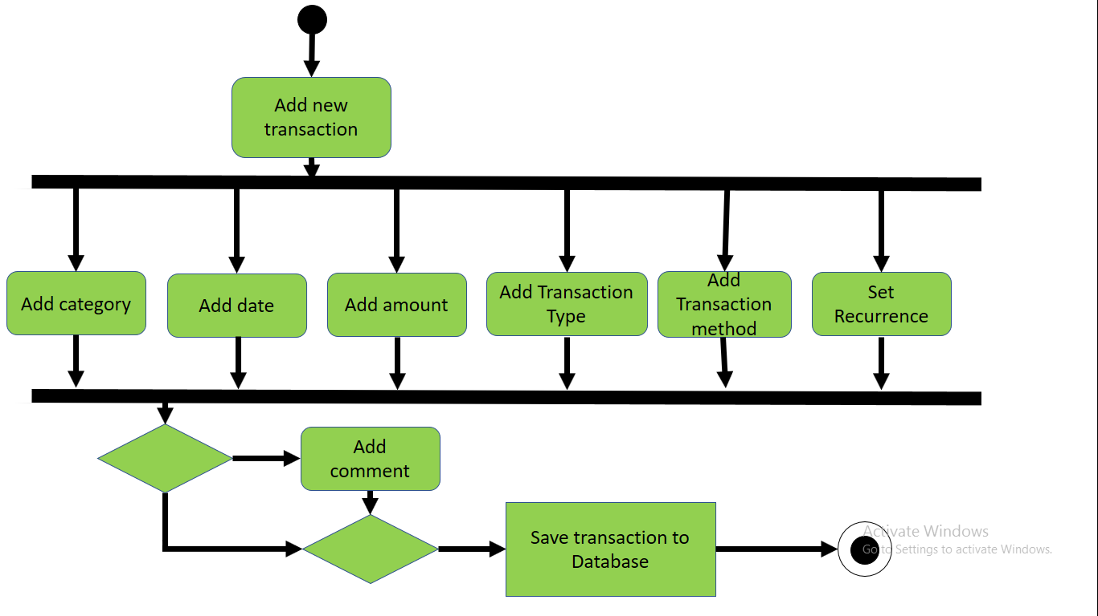
Activity Diagram (Add Transaction)
Add Transaction

Slide 10
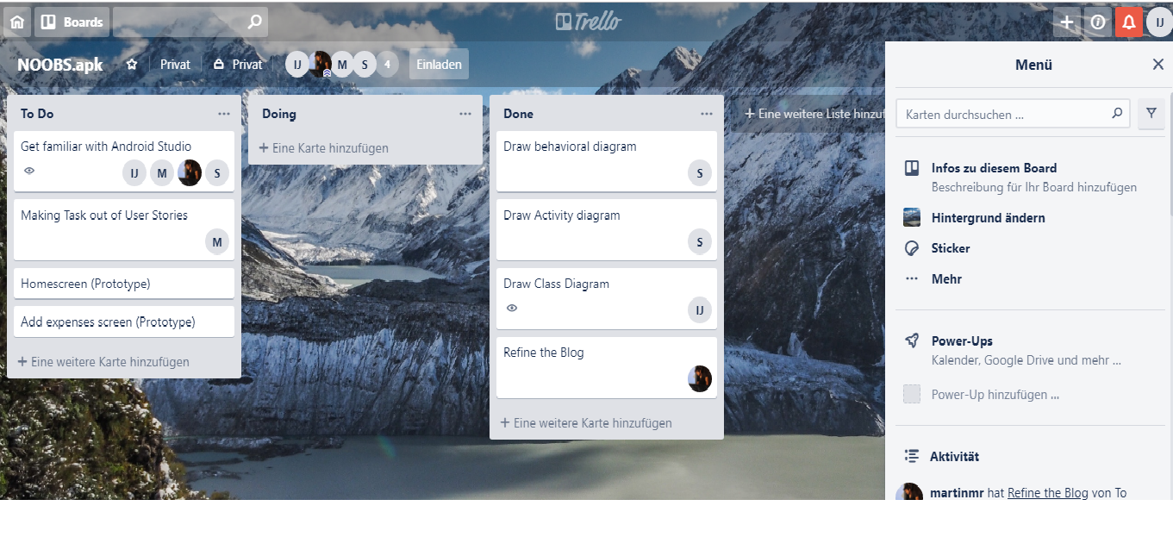
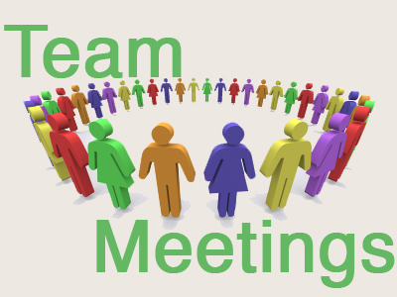
Development Strategy
Trello
&

Slide 11
Thank you for your attention

